Slide 1

Investigation of Dislocation Density
of Directed Energy Deposited 316L Steel at Elevated Temperatures.
B.Tech Project Presentation
By
Jaya Vardhan
Supervisor: Dr. Eswara Prasad Korimilli
Discipline of Metallurgical Engineering and Materials Science
Indian Institute of Technology Indore

Slide 2
Contents
Introduction
Literature Survey
Experimental Procedure
Results
Analysis

Slide 3
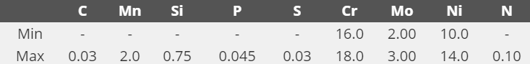
316L Steel
Type 316L stainless steel is a molybdenum bearing austenitic. It is more resistant to general corrosion and pitting than conventional nickel chromium stainless steels such as 302-304.
L-grades can have a maximum carbon content of 0.03%. L-grades are resistant to sensitization in heat treatments. L-grade often have slightly lower strength than standard stainless steels.
Composition of 316L Steel:
https://www.lenntech.com/stainless-steel-316l.htm
Notes:
Low Carbon – High Temperature Applications and Weldability.
C – Increases hardness and strength of Pure Iron.
Ni - Austenitic Stabilizer. (Non-magnetic).
Cr – Corrosion Resistance.
Mo – High temperature Strength, Resist Hydrogen embrittlement (Traps Hydrogen atoms and prevents their diffusivity).
Mn – Improves hot working properties, helps in removing impurities in steel production.
Si – Acts as deoxidiser in steel production
S and P – Improves machinability when added in small amounts. (Detrimental effects on corrosion resistance and weldability)
N – Pitting corrosion resistance.
Sensitization – Material becomes susceptible to intergranular corrosion due to the formation of chromium carbides.

Slide 4
316L Steel
Characteristics:
High Creep Resistance
Excellent Formability
Corrosion Resistance
High Temperature Tensile strength
Applications:
Chemical Industry
Petroleum Refining Equipment
Heat Exchanger Tubes
Evaporators
Marine Applications
Automotive and Aerospace
https://www.lenntech.com/stainless-steel-316l.htm

Slide 5
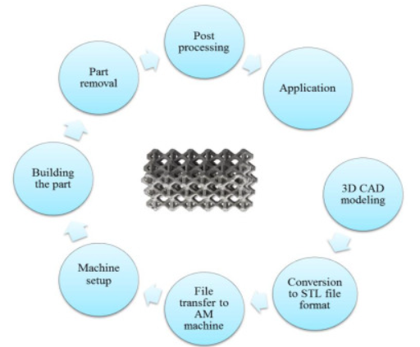
Additive Manufacturing
Additive manufacturing, also known as 3D printing, is a process used to fabricate a physical object from a 3D digital model, typically by laying down and bonding many successive thin layers of materials.
Advantages:
Rapid Process.
Design Freedom and Customization.
Cleaner, Streamlined, and Versatile Workshops.
Disadvantages:
High initial costs.
Size constraints.
Material Limitations.
8 Steps of any
Additive Manufacturing Process
Ian, David, Brent, Additive Manufacturing Technologies.

Slide 6

Additive Manufacturing
Types of Additive Manufacturing Processes:

Slide 7
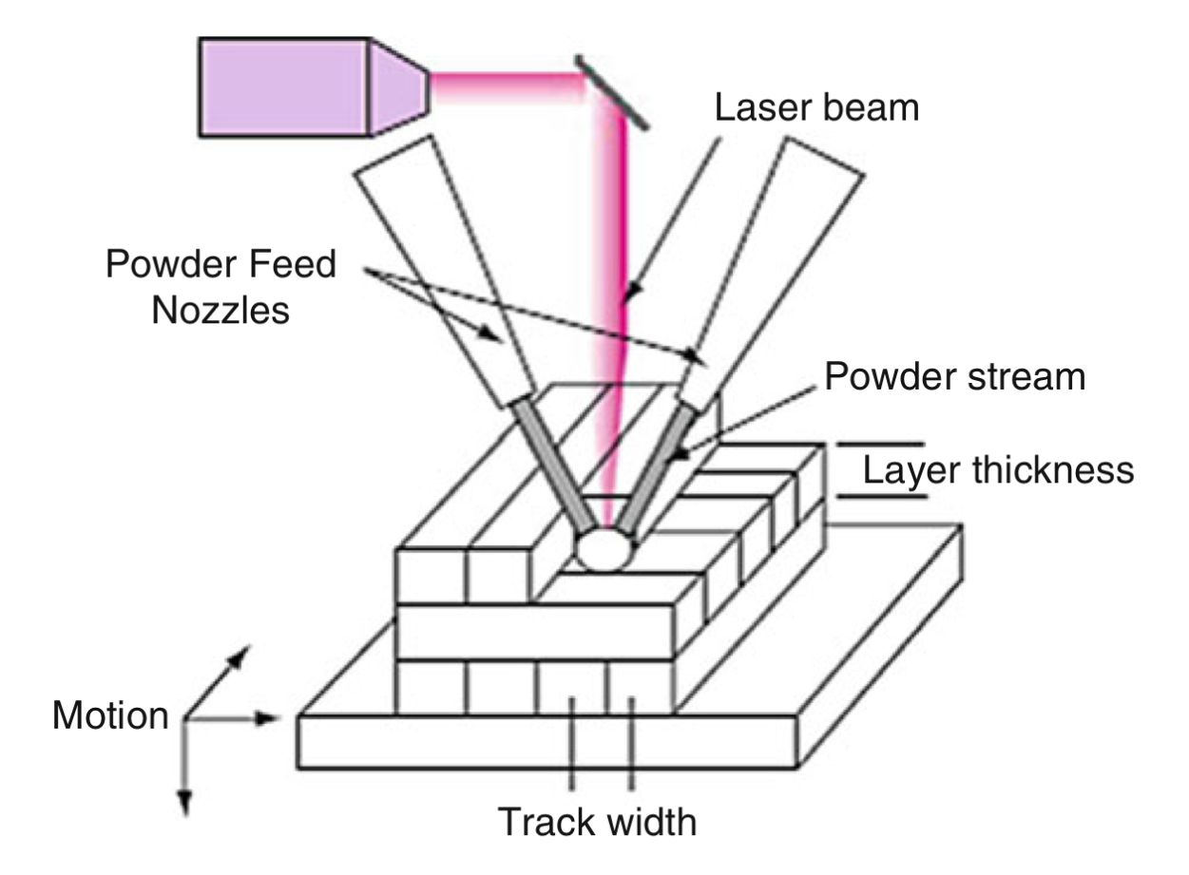
Directed Energy Deposition
Directed Energy Deposition (DED) processes direct energy into a narrow, focused region to heat a substrate, melting the substrate and simultaneously melting material that is being deposited into the substrate’s melt pool.
melt materials as they are being deposited
Advantages
A broad range of feedstock materials.
Manufacturing of larger parts is possible compared to PBF.
High deposition rates.
Laser based Powder DED
Ian, David, Brent, Additive Manufacturing Technologies.
Notes:
The energy density of the beam must be above a critical value to form a melt pool.

Slide 8
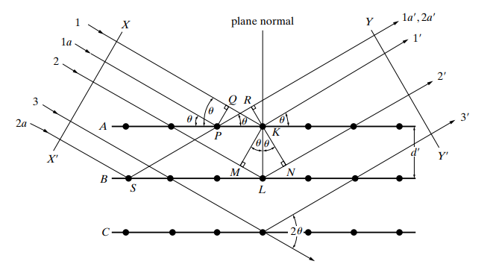


Bragg’s Law
Path Difference between${ 1}^{′}$and$1a^{′}:$
$$QK −PQ=PKCosθ −PKCosθ=0$$
This implies that ${ 1}^{′}$and$1a^{′}$are in same phase.
Diffraction of x-rays by a crystal.
B.D. Cullity, S.R. Stock, Elements of X-Ray Diffraction

Slide 9
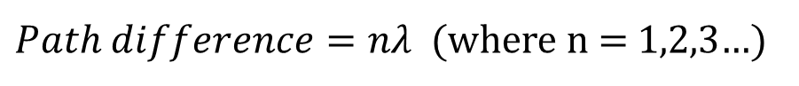

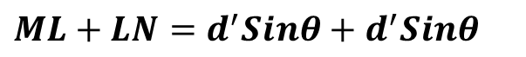
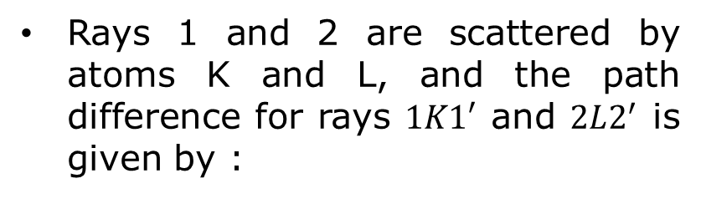
Bragg’s Law
Rays 1 and 2 are scattered by atoms K and L, and the path difference for rays $1K1′$ and $2L2^{′}$ is given by :
$$ML+LN=d^{′}Sinθ+d^{′}Sinθ$$
For Constructive Interference:
$Path difference=n\text{λ}$ (where n = 1,2,3…)
$$⇒n\text{λ}\text{ = 2}d^{′}Sinθ (Bragg^{′}s Law)$$
Diffraction of x-rays by a crystal.
B.D. Cullity, S.R. Stock, Elements of X-Ray Diffraction
Notes:
Phase difference = (2pi/wavelength)*path difference

Slide 10
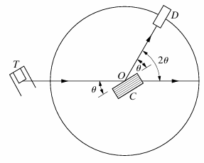
XRD
XRD is a high-precision non-destructive technique that provides important information about the structural characteristics of the materials by enabling chemical composition identification.
Every crystalline substance gives a pattern; the same substance always gives the same pattern; and in a mixture of substances, each produces its pattern independently of the others – Hull (1919).
Working Principle of XRD:
X-rays from the tube T are incident on a crystal C which may be set at any desired angle to the incident beam by rotation about an axis through O. D is a detector which measures the intensity of the diffracted x-rays.
Schematic of XRD
B.D. Cullity, S.R. Stock, Elements of X-Ray Diffraction
Notes:
Why angle with plane is considered and not angle with normal?

Slide 11
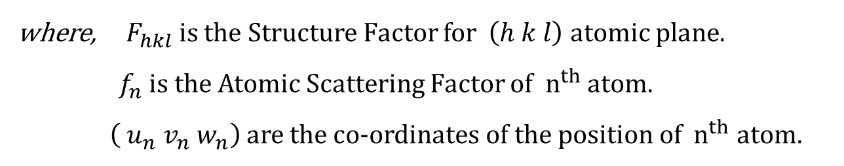
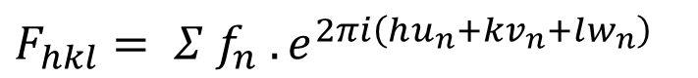
XRD
Structure Factor: The resultant wave scattered by all the atoms of the unit cell.
$$F_{hkl}= Σ f_{n} . e^{2πi\left(hu_{n}+kv_{n}+lw_{n}\right)}$$
where,${ F}_{hkl}$ is the Structure Factor for $\left(h k l\right)$atomic plane.
$f_{n}$ is the Atomic Scattering Factor of ${ n}^{th}$ atom.
$\left( u_{n}{ v}_{n} w_{n}\right)$ are the co-ordinates of the position of ${ n}^{th}$ atom.
$${If F}_{hkl}=0,it means that the X−ray diffraction intensity for \left(h k l\right) plane is zero.$$
B.D. Cullity, S.R. Stock, Elements of X-Ray Diffraction

Slide 12
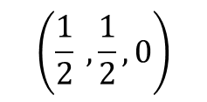
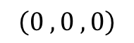
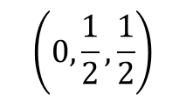
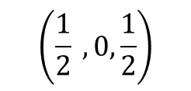
XRD
Structure Factor for FCC Unit cell: The FCC unit cell contains 4 atoms. These 4 atoms are positioned at the following fractional coordinates within the unit cell -
$$\left(\frac{1}{2} , \frac{1}{2}, 0\right)$$
$$\left(\frac{1}{2} ,0,\frac{1}{2}\right)$$
$$\left(0,\frac{1}{2},\frac{1}{2}\right)$$
$$\left(0 , 0 , 0\right)$$
$$(F_{hkl})_{FCC} =f (e^{2πi\left(h\left(0\right) + k\left(0\right) + l\left(0\right)\right)}+e^{2πi\left(h\left(\frac{1}{2}\right) + k\left(\frac{1}{2}\right) + l\left(0\right)\right)} +e^{2πi\left(h\left(\frac{1}{2}\right) + k\left(0\right) + l\left(\frac{1}{2}\right)\right) }+e^{2πi\left(h\left(0\right) + k\left(\frac{1}{2}\right) + l\left(\frac{1}{2}\right)\right)} )$$
$$(F_{hkl})_{FCC} =f (1 +e^{πi\left(h + k\right)} +e^{πi\left(h + l\right) }+e^{πi\left(k + l\right)} )$$
$(F_{hkl})_{FCC}=4f$ (for unmixed indices) $(F_{hkl})_{FCC} =0$(for mixed indices)
Thus, reflections may occur for such planes as (111),(200),and (220) etc

Slide 13
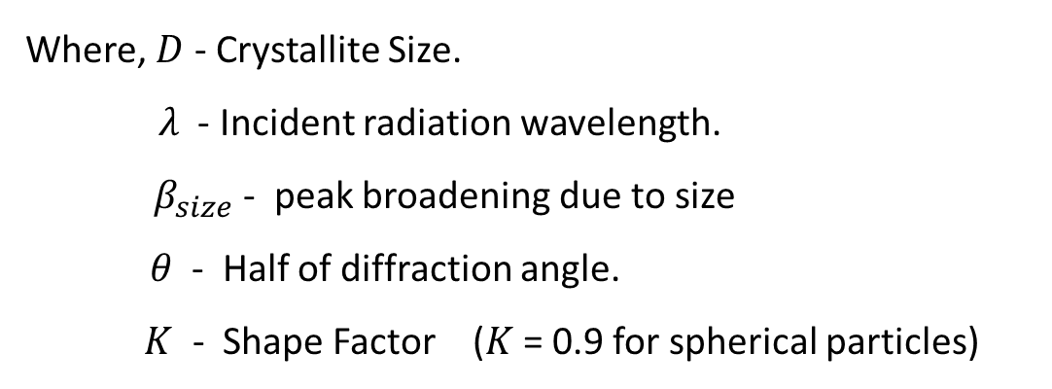
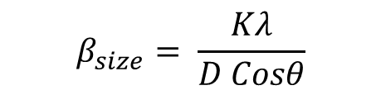
XRD
Peak Broadening: XRD peaks broaden due to 3 factors –
Size broadening
Strain broadening
Instrument broadening
Size Broadening:
Where, $D$ - Crystallite Size.
$λ$- Incident radiation wavelength.
$β_{size}$ - peak broadening due to size
$θ$ - Half of diffraction angle.
$K$ - Shape Factor ($K$ = 0.9 for spherical particles)
$$β_{size}= \frac{Kλ}{D Cosθ}$$
Scherrer’s Equation

Slide 14
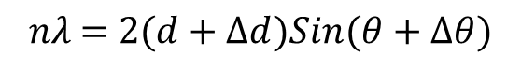
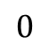
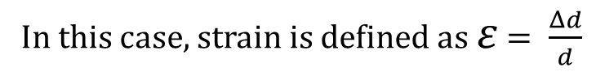
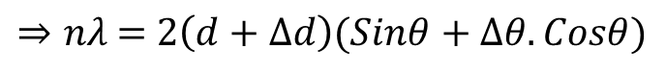
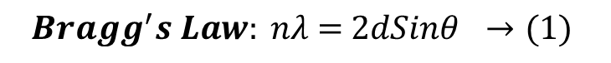
XRD
Size Broadening: Differentiating Bragg’s law yields the relation between the strain and strain broadening.
$$Bragg^{′}s Law: n\text{λ}\text{ = 2}dSinθ →(1)$$
In this case, strain is defined as $ε$ $= \frac{Δd}{d}$
For a change in the interplanar spacing ($Δd$), there is a corresponding change in the Bragg angle ($Δθ$)
$$n\text{λ}\text{ = 2}(d+Δd)Sin(θ+Δθ)$$
$$n\text{λ}\text{ = 2}\left(d+Δd\right)(Sinθ.CosΔθ+SinΔθ.Cosθ)$$
Assuming $Δθ$ is small, $CosΔθ=1$ and $SinΔθ=Δθ$
$$⇒n\text{λ}\text{ = 2}\left(d+Δd\right)(Sinθ+Δθ.Cosθ)$$
$$0$$
$$⇒n\text{λ}\text{ = 2}\text{(}dSinθ+dΔθCosθ+ΔdSinθ+ΔdΔθCosθ)$$

Slide 15
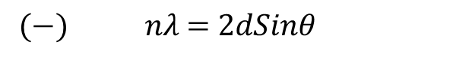
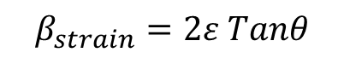
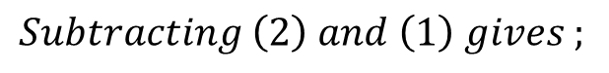
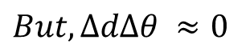
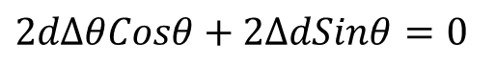
XRD
$$But, ΔdΔθ ≈0$$
$$Therefore, n\text{λ}\text{ = 2(}dSinθ+dΔθCosθ+ΔdSinθ) →(2)$$
$$Subtracting \left(2\right) and \left(1\right) gives ;$$
$$n\text{λ}\text{ = 2}dSinθ+2dΔθCosθ+2ΔdSinθ$$
$$(−) n\text{λ}\text{ = 2}dSinθ$$
$$2dΔθCosθ+2ΔdSinθ=0$$
$⇒Δθ=−\frac{Δd}{d} Tanθ =−$ $ε$ $Tanθ$ ( negative sign indicates direction of peak shift)
$$Peak Broadening due to strain β_{strain}=2Δθ$$
$$β_{strain}=2ε Tanθ$$

Slide 16
XRD
Instrument Broadening: This refers to the additional broadening of diffraction peaks caused by imperfections and limitations of the instrument itself, rather than the sample.
$→$ Factors contributing to Instrument Broadening:
Detector resolution
Crystal imperfections in optics
Instrument vibrations
X-ray source size
Notes:
Limited resolution of the detector used to measure the diffraction pattern can contribute to peak broadening.
Imperfections in monochromators or focusing crystals within the X-ray instrument can distort the beam and broaden peaks.
Mechanical vibrations within the instrument can also cause broadening.
The finite size of the X-ray source can lead to divergence, which affects the resolution and broadens the peaks.

Slide 17
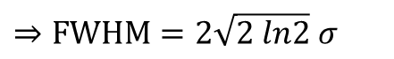
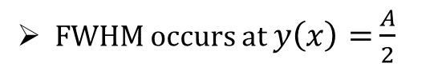
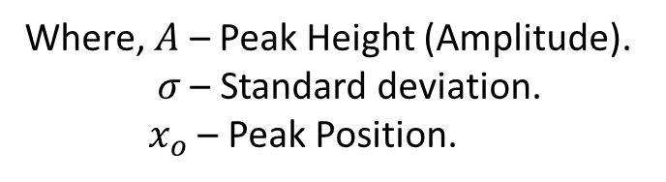
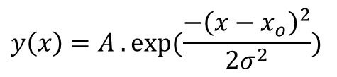
Curve Fitting
Curve fitting of a X-ray diffractogram is essential because:
Accurate Peak identification
Quantitative Analysis
Noise Reduction
The Gaussian function is often the best choice for fitting a X-ray diffractogram due to its ability to accurately represent the shape of diffraction peaks, which are typically symmetrical and bell-shaped.
$$y\left(x\right)=A . exp⁡(\frac{−{\left(x−x_{o}\right)}^{2}}{2σ^{2}})$$
Where, $A$ – Peak Height (Amplitude).
$σ$ – Standard deviation.
${ x}_{o}$ – Peak Position.
Gauss Function –
FWHM occurs at $y\left(x\right)=$ $\frac{A}{2}$
$$⇒FWHM=2\sqrt{2 ln2} σ$$
Notes:
Curve fitting is a process of finding a mathematical function that best represents a set of data points.

Slide 18
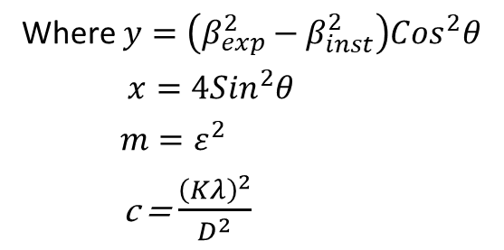
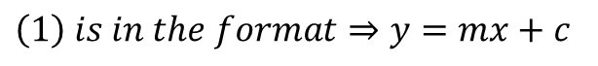
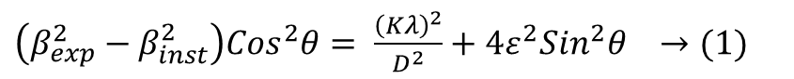
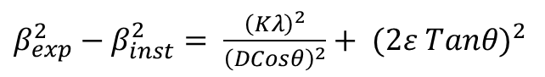
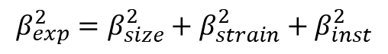
Strain Calculation
Since Gaussian broadening combines quadratically, the relation becomes additive in terms of squares.
$$β_{exp}^{2}=β_{size}^{2}+β_{strain}^{2}+β_{inst}^{2}$$
$β_{exp}^{2}−β_{inst}^{2}= \frac{{\left(Kλ\right)}^{2}}{{\left(DCosθ\right)}^{2}}+ {(2ε Tanθ)}^{2}$
$\left(β_{exp}^{2}−β_{inst}^{2}\right){Cos}^{2}θ= \frac{{\left(Kλ\right)}^{2}}{D^{2}}+4ε^{2}{Sin}^{2}θ →(1)$
$$\left(1\right) is in the format⇒y=mx+c$$
Where $y=\left(β_{exp}^{2}−β_{inst}^{2}\right){Cos}^{2}θ$
$x=4{Sin}^{2}θ$
$m=ε^{2}$
c = $\frac{{\left(Kλ\right)}^{2}}{D^{2}}$
Therefore, Strain and Crystallite size can be estimated from this relation.
B.D. Cullity, S.R. Stock, Elements of X-Ray Diffraction

Slide 19
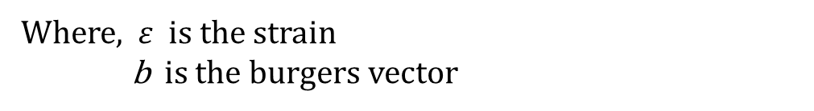
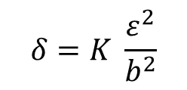

Dislocation Density
Dislocation Density ($δ$) is be defined as:
$$δ= \frac{Strain Energy of Lattice}{Energy of Dislocation}$$
This Equation can be written as:
$$δ=K \frac{ε^{2}}{b^{2}}$$
Where, $ε$ is the strain
b is the burgers vector
For FCC metals, K = 16.1 and $b= \frac{a}{\sqrt{2}}$ along [110] direction
G. K. Williamson & R. E. Smallman (1956)

Slide 20
Experimental Procedure
Sample Preparation: 1300W_DED_316L steel samples were cut using an Electric Discharge Machine (EDM).
TGA: To assess the thermal stability and potential weight loss of the samples at elevated temperatures, TGA was conducted.
XRD: XRD measurements were performed on the samples to analyse their crystallographic structure. The samples were heated to 400°C, 600°C, 800°C, 1000°C, and 1150°C, and after reaching each temperature, XRD readings were recorded. An initial reading was taken at 25°C for all samples before heating.
Inverted Microscope and Vickers Hardness Tester were used to obtain microstructures and hardness values respectively.

Slide 21
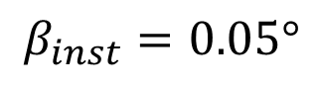
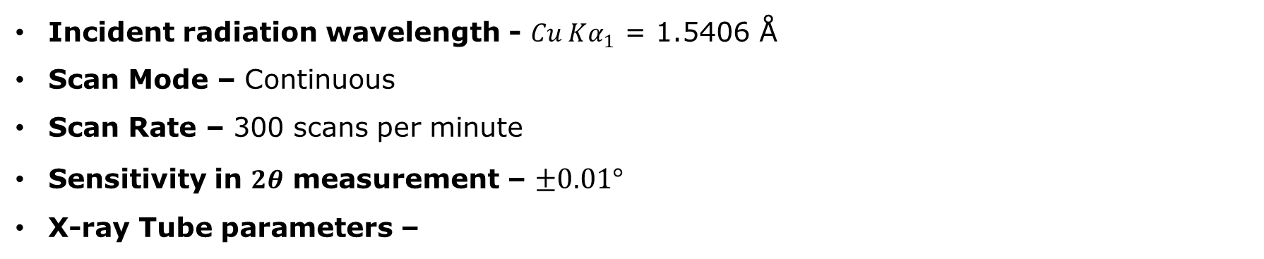
XRD Parameters
High Temperature XRD of 1300W DED 316L sample is performed at 400°C, 600°C, 800°C, 1000°C, and 1150°C.
Incident radiation wavelength - $Cu Kα_{1}$ = 1.5406 Å
Scan Mode – Continuous
Scan Rate – 300 scans per minute
Sensitivity in $2θ$ measurement – $±0.01°$
X-ray Tube parameters –
Cathode – Tungsten; Anode – Copper; Voltage – 45kV; Current – 30mA
Sample Stage – Pt heat strip (direct heating)
Thermocouple – Pt 10% RhPt
$$β_{inst}=0.05°$$

Slide 22
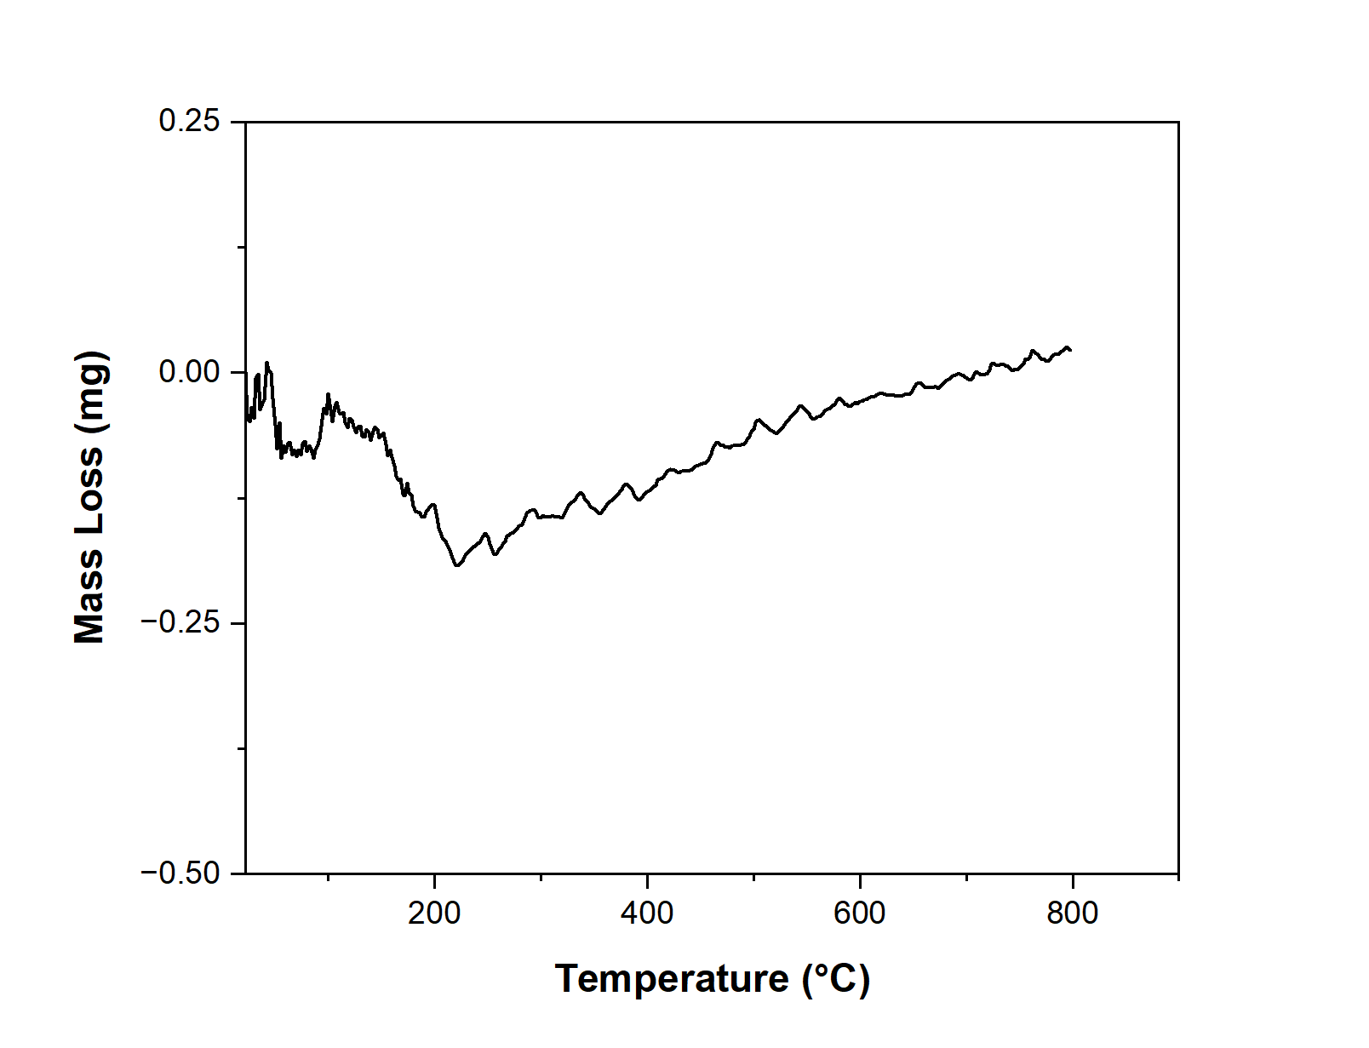
Results
TGA
The initial dip is attributed to the removal of porosity within the material, followed by a stable ascend.
The absence of significant weight loss throughout the analysis confirmed that no mass loss occurred, indicating the sample's readiness for subsequent high-temperature XRD measurements.

Slide 23
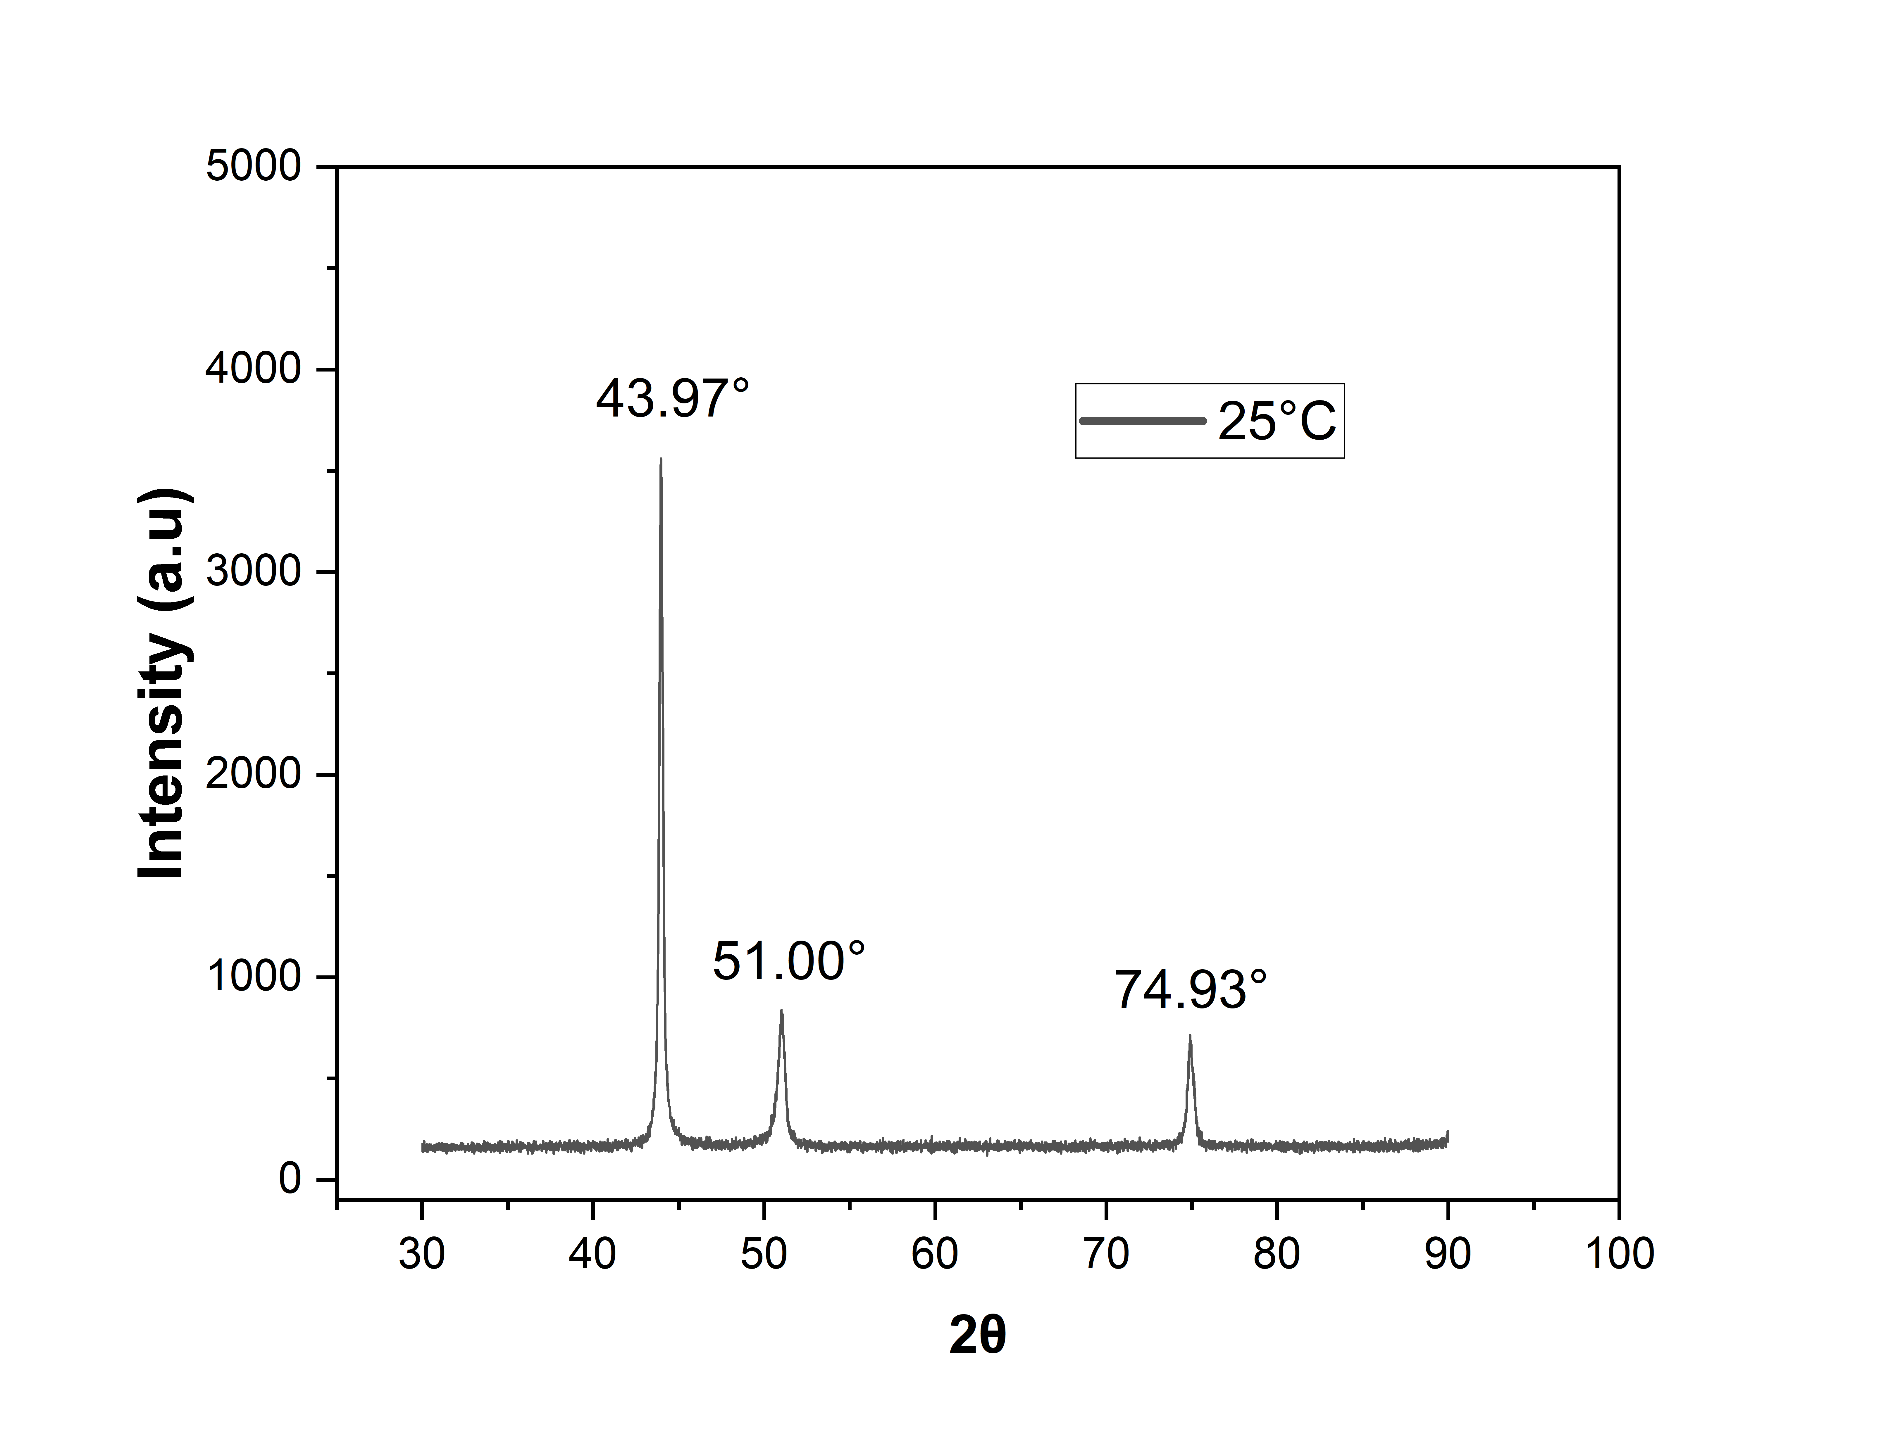
Results
Determining Crystal Structure
The ratio of final values is 3 : 3.98 : 8.01.
The ratio of first 3 peaks of FCC is 3 : 4 : 8.
Therefore, Crystal structure of 316L steel is FCC.
(Degrees)
Peak No. | d-Spacing (Å) | 1/d² | Ratio | Ratio * 2 | Ratio * 3
1 | 2.06 | 0.24 | 1.00 (Peak 1 / Peak 1) | 2.00 | 3.00
2 | 1.79 | 0.31 | 1.32 (Peak 2 / Peak 1) | 2.64 | 3.98
3 | 1.27 | 0.64 | 2.67 (Peak 3 / Peak 1) | 5.34 | 8.01

Slide 24
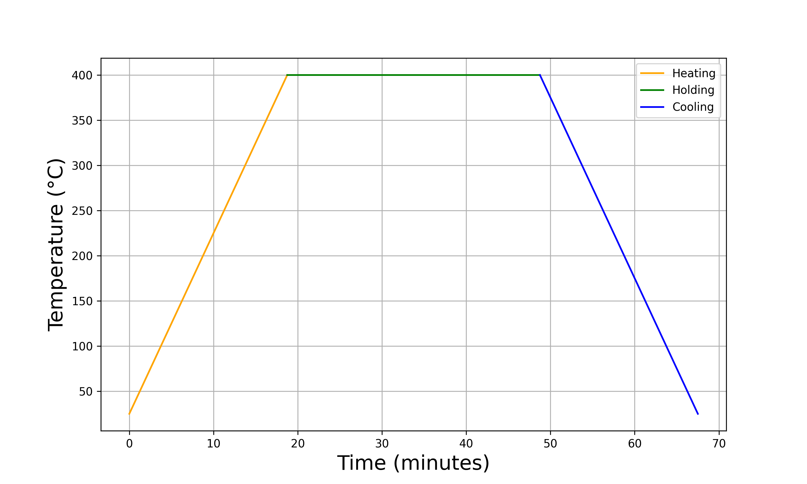
Results
XRD at 400°C
400°C
Heating Cycle
-20°C/min
20°C/min
25°C

Slide 25
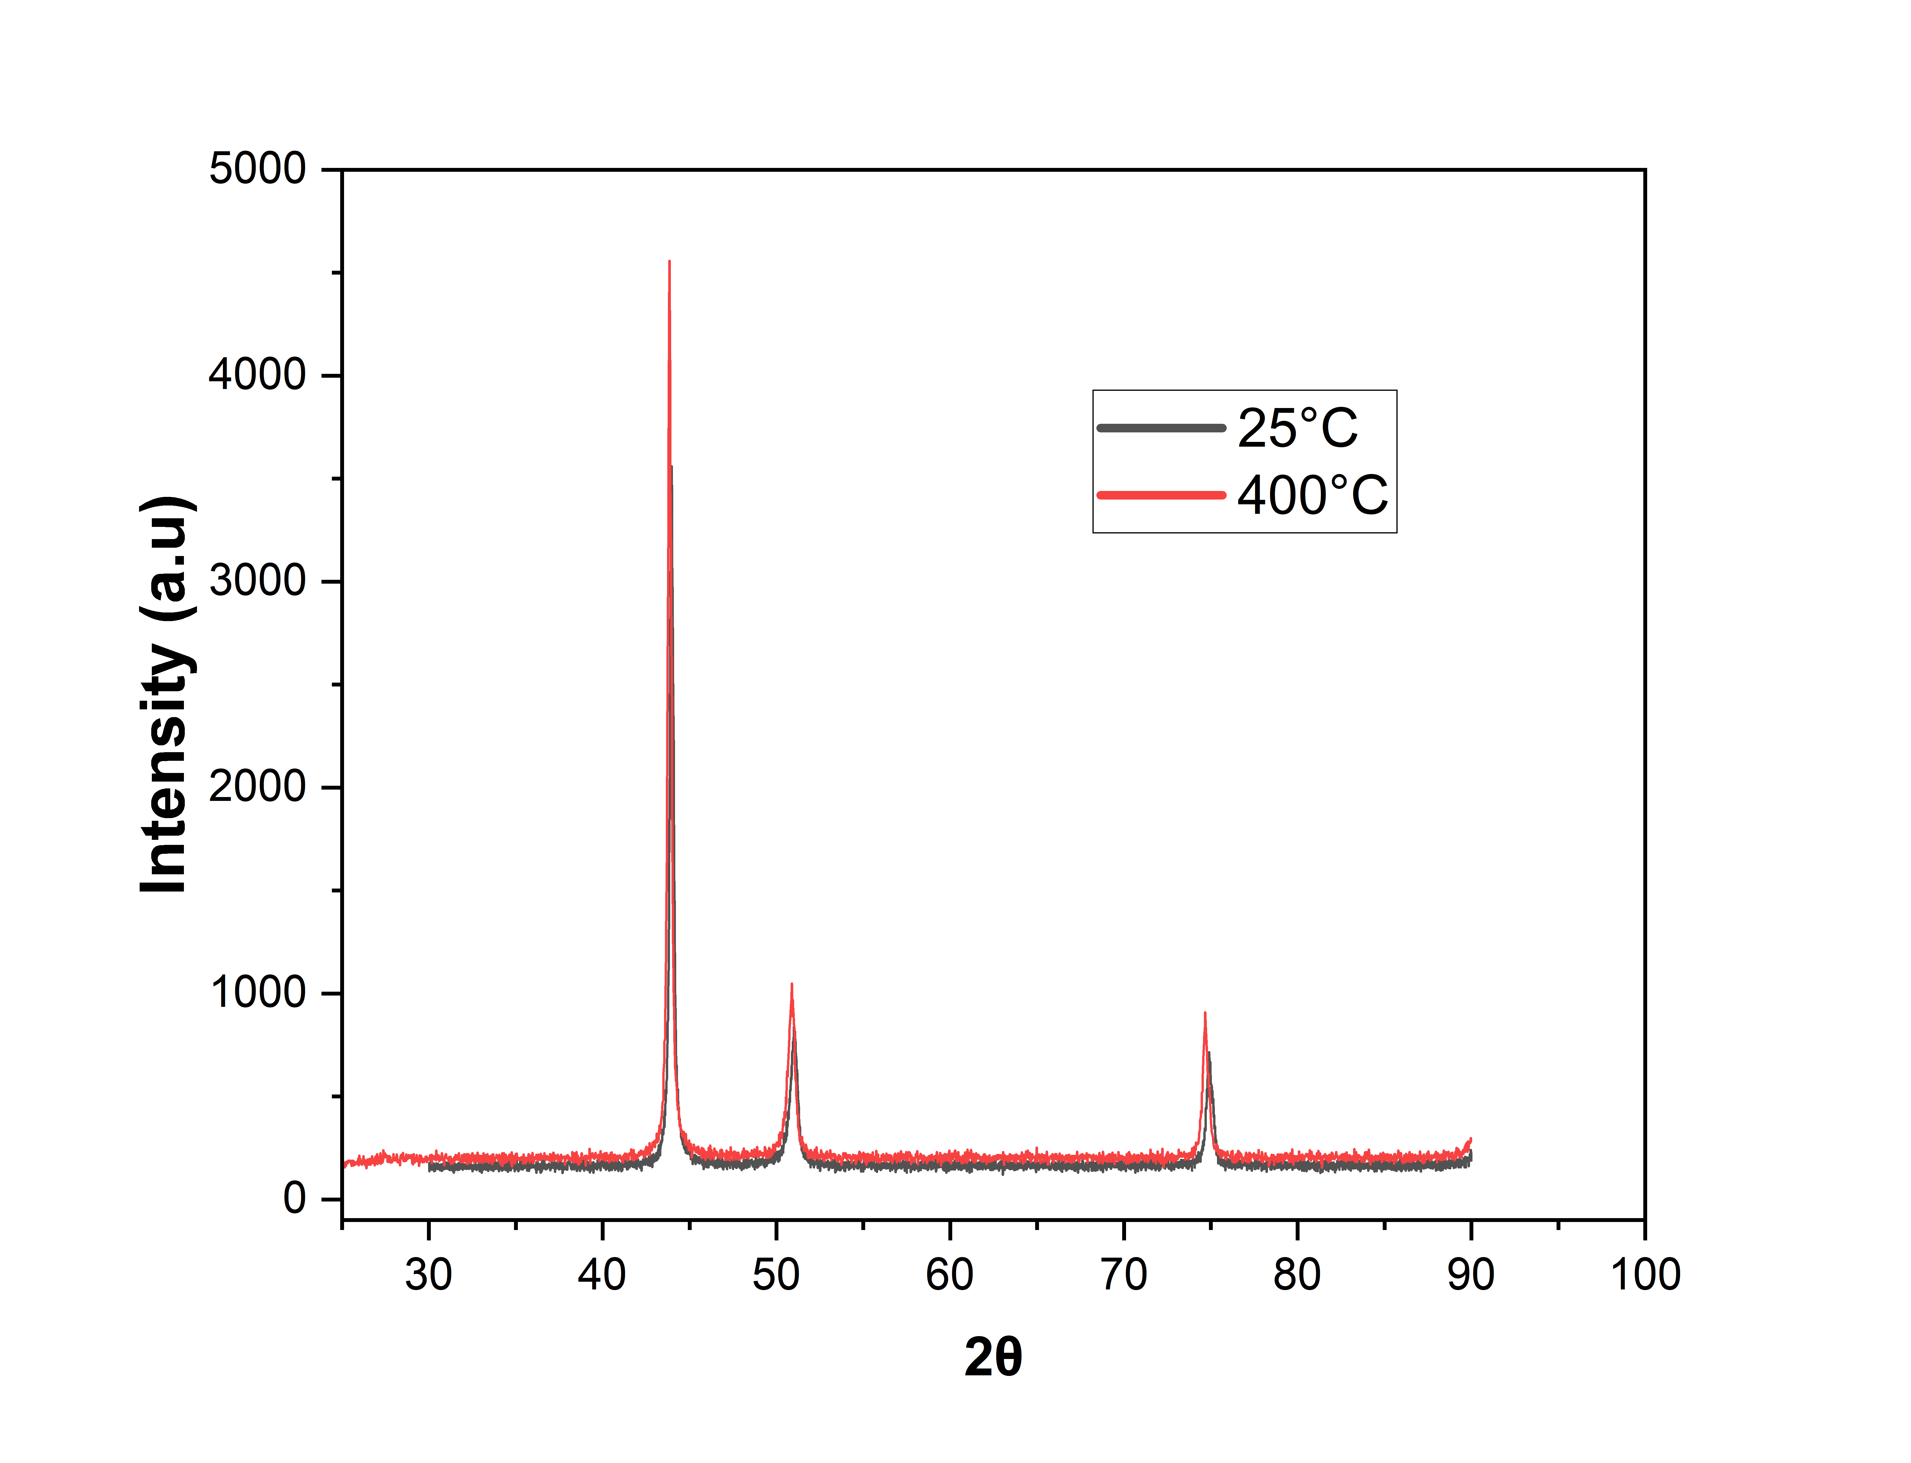
Results
XRD at 400°C
At 25°C
Peak Position (2θ) | FWHM (β)
43.97° | 0.30°
51.00° | 0.56°
74.93° | 0.48°
At 400°C
Peak Position (2θ) | FWHM (β)
43.85° | 0.30°
50.87° | 0.54°
74.70° | 0.45°
(Degrees)

Slide 26
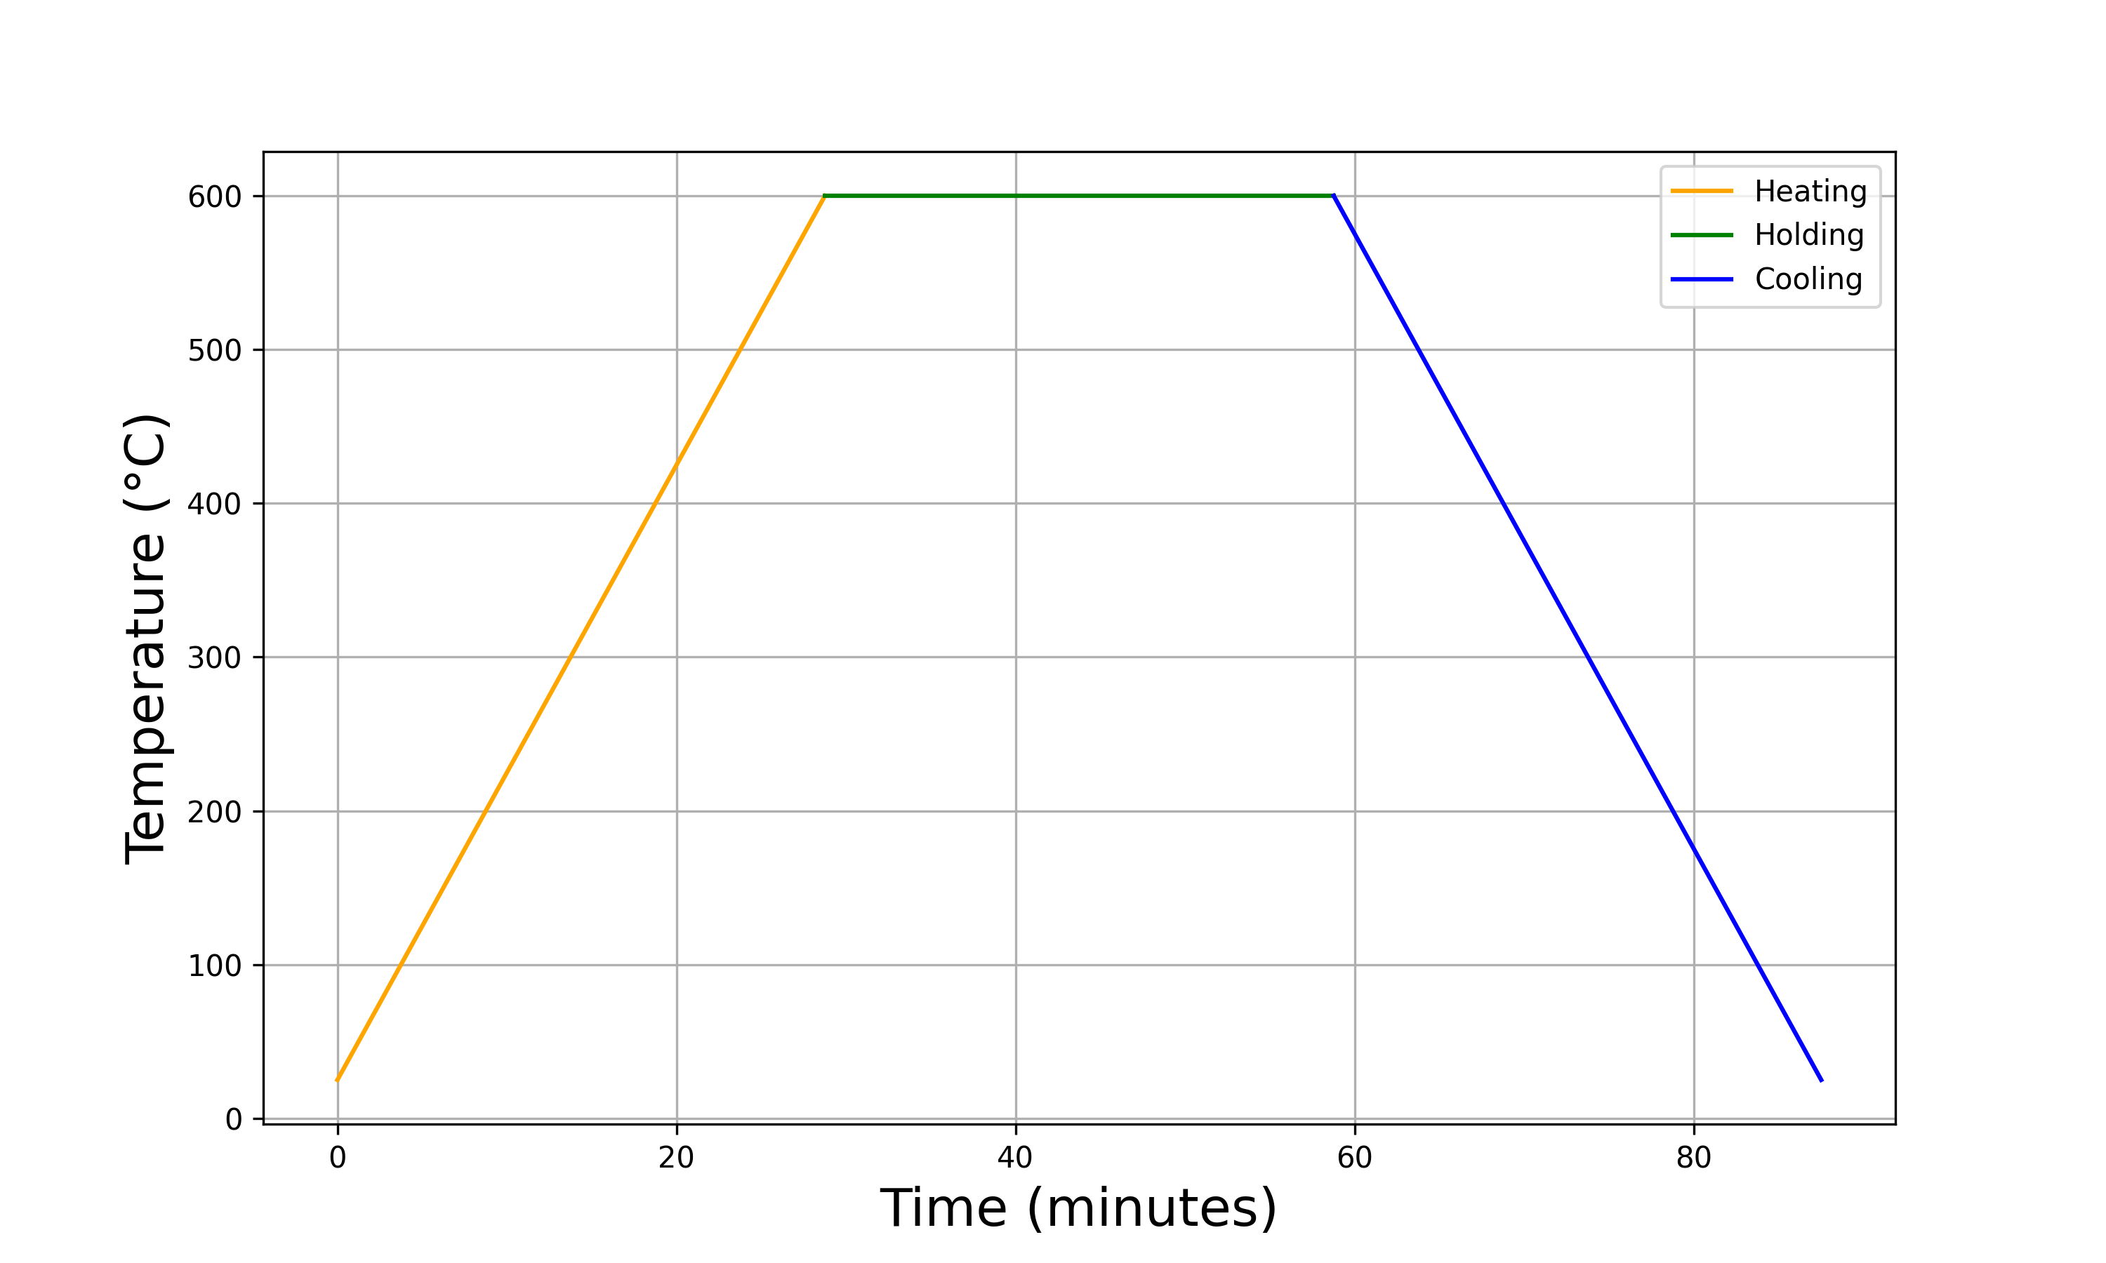
Results
XRD at 600°C
600°C
Heating Cycle
-20°C/min
20°C/min
25°C

Slide 27
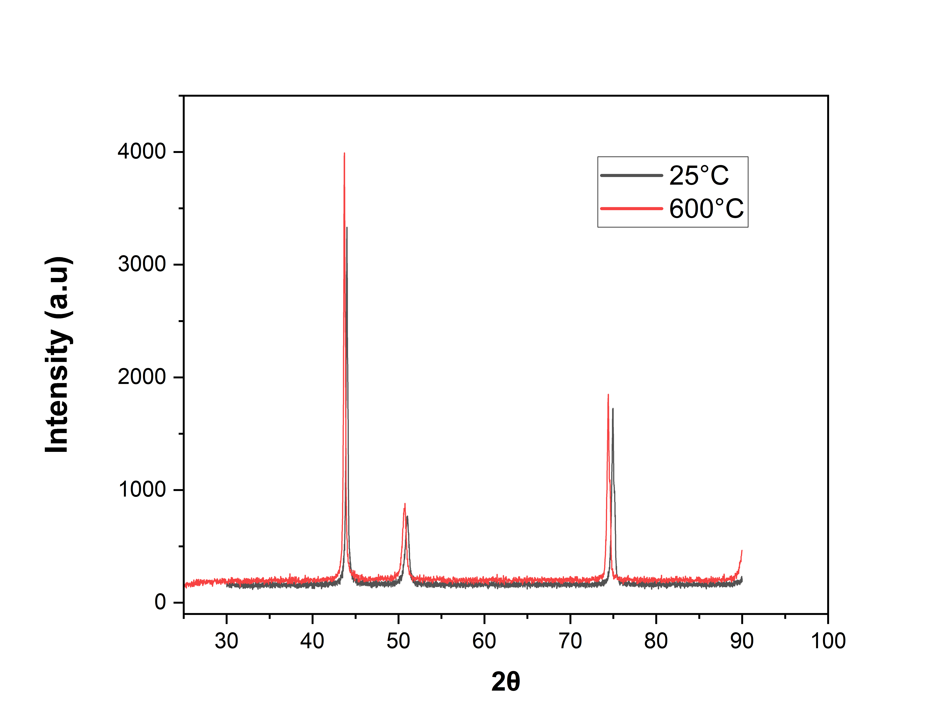
Results
XRD at 600°C
At 25°C
Peak Position (2θ) | FWHM (β)
44.00° | 0.27°
51.00° | 0.58°
74.96° | 0.42°
At 600°C
Peak Position (2θ) | FWHM (β)
43.71° | 0.27°
50.68° | 0.58°
74.43° | 0.41°
(Degrees)

Slide 28
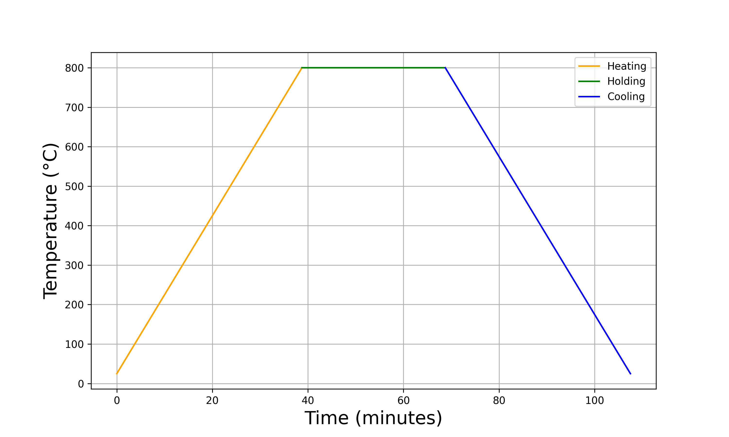
Results
XRD at 800°C
800°C
Heating Cycle
-20°C/min
20°C/min
25°C

Slide 29
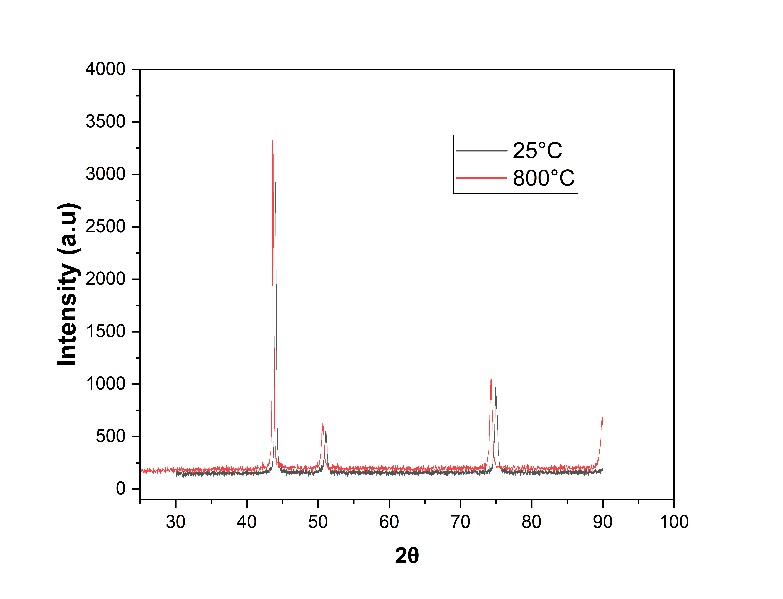
Results
XRD at 800°C
At 25°C
Peak Position (2θ) | FWHM (β)
44.03° | 0.27°
51.08° | 0.45°
75.00° | 0.48°
At 800°C
Peak Position (2θ) | FWHM (β)
43.67° | 0.25°
50.66° | 0.46°
74.30° | 0.46°
(Degrees)

Slide 30
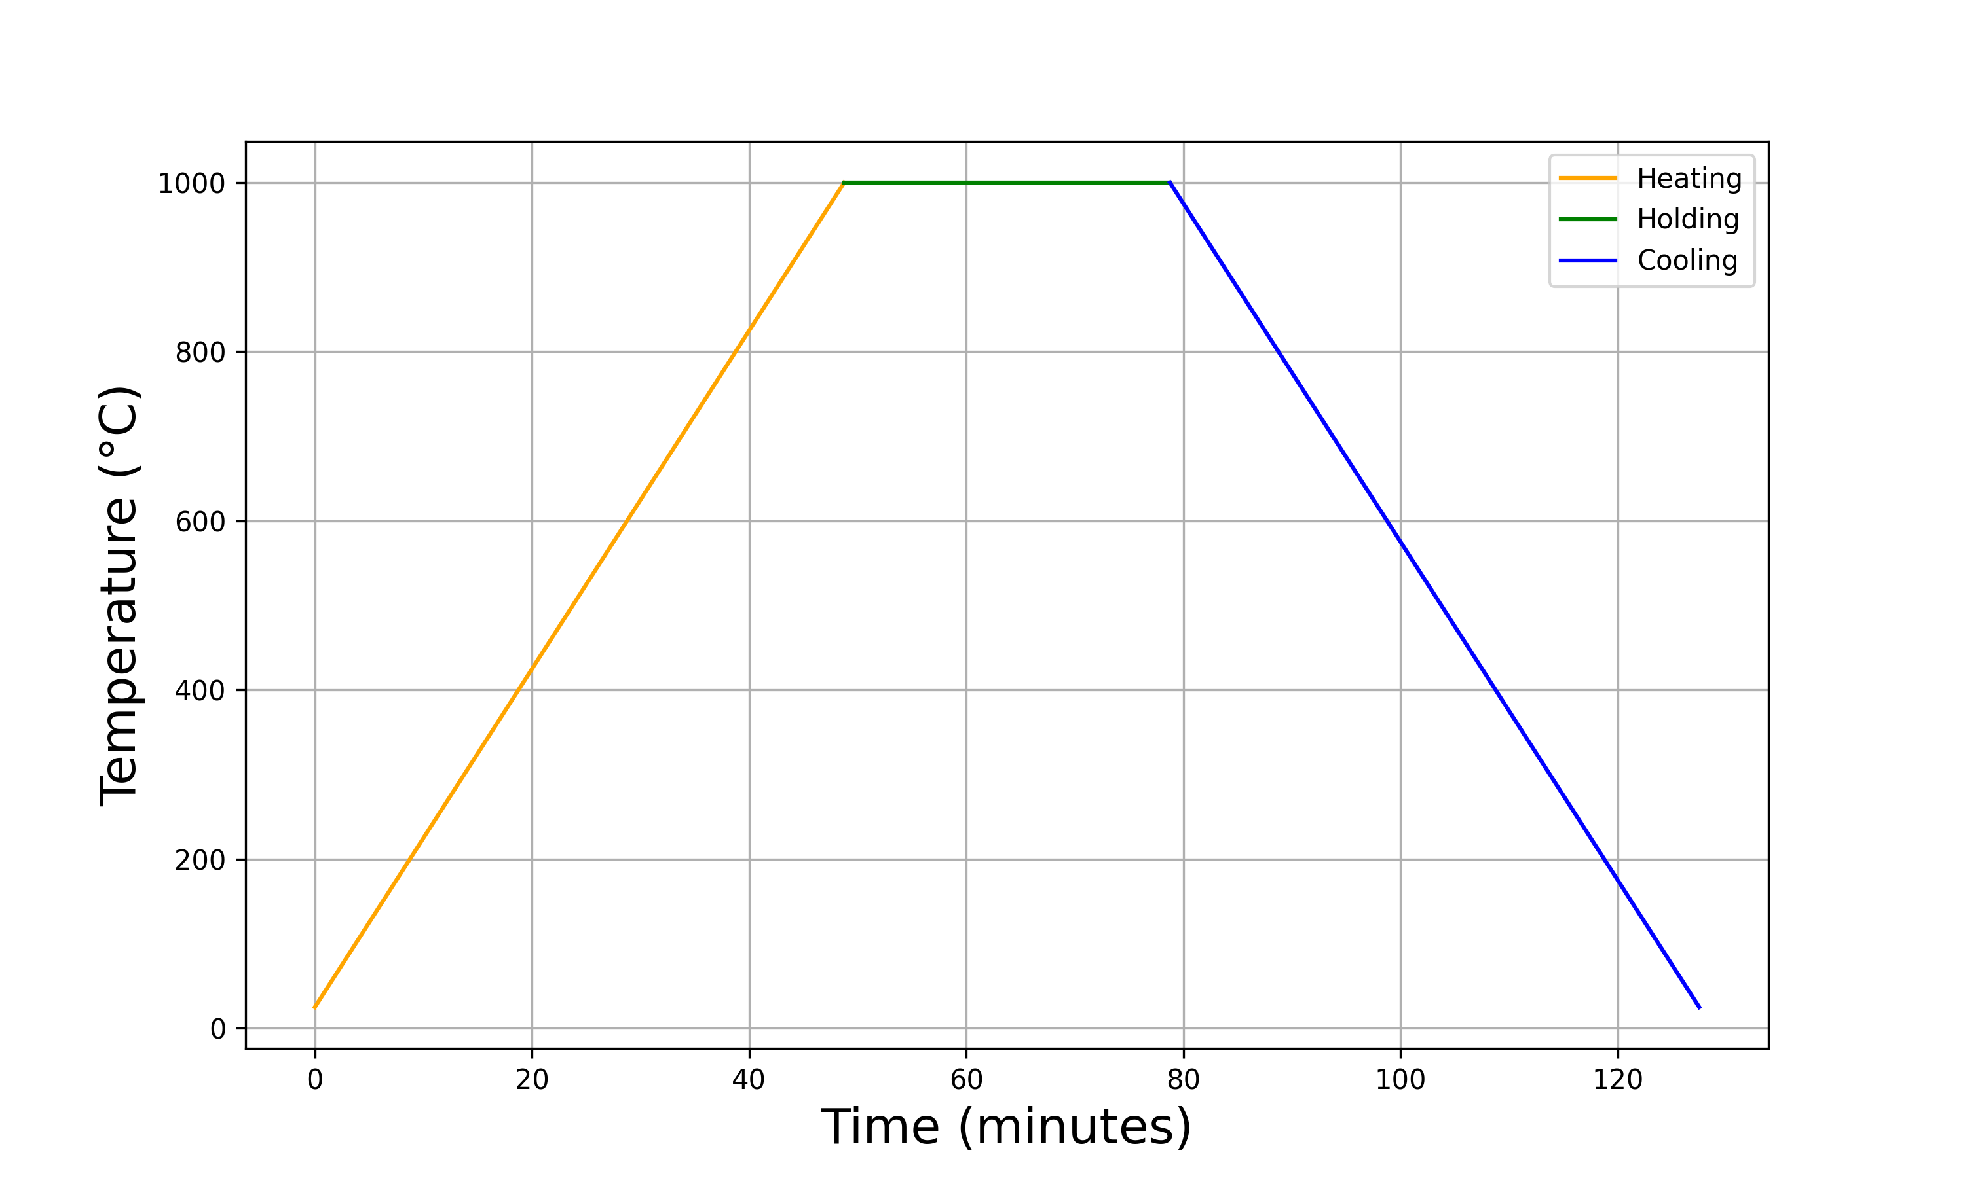
Results
XRD at 1000°C
1000°C
Heating Cycle
-20°C/min
20°C/min
25°C

Slide 31
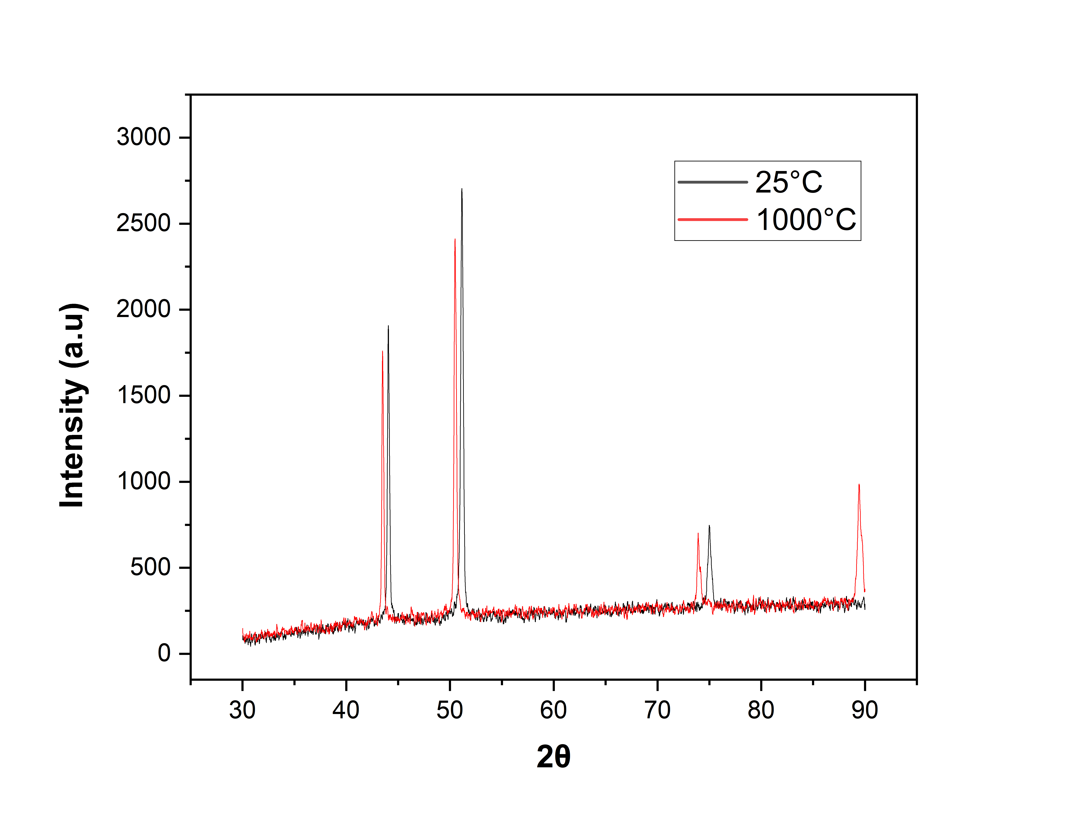
Results
XRD at 1000°C
At 25°C
Peak Position (2θ) | FWHM (β)
44.07° | 0.24°
51.16° | 0.31°
75.02° | 0.54°
At 1000°C
Peak Position (2θ) | FWHM (β)
43.52° | 0.21°
50.51° | 0.28°
73.97° | 0.45°
(Degrees)

Slide 32
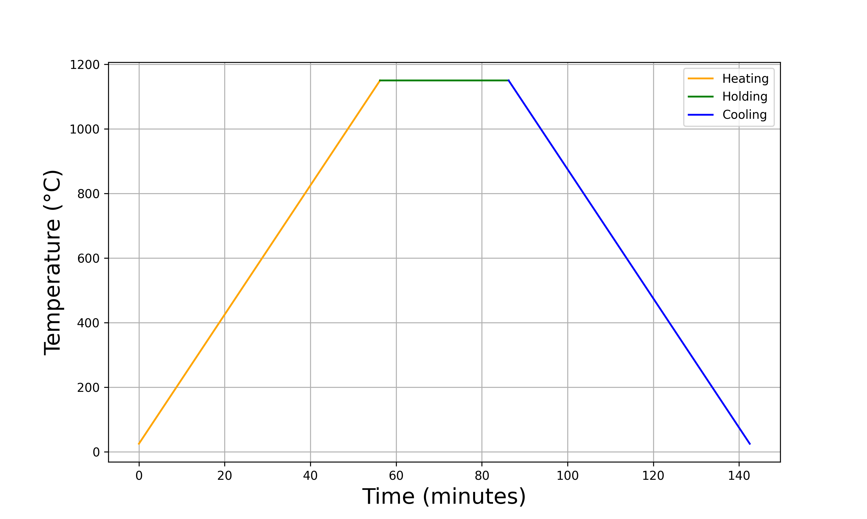
Results
XRD at 1150°C
1150°C
Heating Cycle
-20°C/min
20°C/min
25°C

Slide 33

Results
XRD at 1150°C
At 25°C
Peak Position (2θ) | FWHM (β)
44.07° | 0.32°
51.14° | 0.48°
75.02° | 0.54°
At 1150°C
Peak Position (2θ) | FWHM (β)
43.56° | 0.22°
50.57° | 0.33°
73.96° | 0.43°
(Degrees)

Slide 34



Results
Dislocation Density at 400°C
25°C
400°C
 | Crystallite Size (nm) | Strain | Dislocation Density (m⁻²)
25°C | $$36.0$$ | $$6.30∗{10}^{−3}$$ | $$1.01∗{10}^{16}$$
400°C | $$31.5$$ | $$5.43∗{10}^{−3}$$ | $$7.42∗{10}^{15}$$

Slide 35



Results
Dislocation Density at 600°C
25°C
600°C
 | Crystallite Size (nm) | Strain | Dislocation Density (m⁻²)
25°C | $$42.0$$ | $$5.99∗{10}^{−3}$$ | $$9.11∗{10}^{15}$$
600°C | $$30.9$$ | $$5.40∗{10}^{−3}$$ | $$7.26∗{10}^{15}$$

Slide 36



Results
Dislocation Density at 800°C
25°C
800°C
 | Crystallite Size (nm) | Strain | Dislocation Density (m⁻²)
25°C | $$38.4$$ | $$6.37∗{10}^{−3}$$ | $$1.03∗{10}^{16}$$
800°C | $$30.9$$ | $$5.38∗{10}^{−3}$$ | $$7.15∗{10}^{15}$$

Slide 37

Results
Dislocation Density at 1000°C
25°C
1000°C
 | Crystallite Size (nm) | Strain | Dislocation Density (m⁻²)
25°C | $$37.0$$ | $$6.31∗{10}^{−3}$$ | $$1.01∗{10}^{16}$$
1000°C | $$31.1$$ | $$5.36∗{10}^{−3}$$ | $$7.07∗{10}^{15}$$

Slide 38


Results
Dislocation Density at 1150°C
25°C
1150°C
 | Crystallite Size (nm) | Strain | Dislocation Density (m⁻²)
25°C | $$41.4$$ | $$6.01∗{10}^{−3}$$ | $$9.19∗{10}^{15}$$
1150°C | $$40.9$$ | $$5.32∗{10}^{−3}$$ | $$6.91∗{10}^{15}$$

Slide 39





Results
Microstructures
400°C
5.93 μm
800°C
7.48 μm
600°C
6.93 μm
1000°C
12.45 μm
1150°C
8.82 μm

Slide 40
Analysis
Peak Shift vs Temperature
(111) Peak

Slide 41
Analysis
Peak Shift vs Temperature
(200) Peak

Slide 42
Analysis
Peak Shift vs Temperature
(220) Peak

Slide 43

Analysis
Reason for peak shift at elevated temperatures
A crystal does not have its atoms arranged on a perfectly regular lattice extending from one side of the crystal to the other.
Let’s say “𝛼” is the maximum misorientation angle.
If “𝜃” is the incident beam angle, diffraction occurs around “𝜃+ 𝛼.”
“𝛼” decreases at elevated temperatures due to “polygonization” thus causing peak shift towards left side.
Representation of an actual lattice showing misorientation

Slide 44

Analysis
Lattice Parameter vs Temperature
$$d= \frac{λ}{2Sinθ}$$
Lattice Parameter $a=d\sqrt{h^{2}+ k^{2}+l^{2} }$

Slide 45
Analysis
Grain Size vs Temperature

Slide 46
Analysis
Strain vs Temperature

Slide 47
Analysis
Dislocation Density vs Temperature

Slide 48
Analysis
Hardness vs Temperature

Slide 49
Thank You!

Slide 50

400°C
600°C

